Slide 1

TLP: A Deep Learning-Based Cost Model for Tensor Program Tuning
Yi Zhai, Yu Zhang, Shuo Liu, Xiaomeng Chu, Jie Peng, Jianmin Ji and Yanyong Zhang
University of Science and Technology of China
ASPLOS 2023; Session 5C; 1:40 PM - 3:20 PM, Tuesday, March 28

Slide 2
Tensor Compiler
From the program language perspective:
Python / C++
Workloads
High Level Graph IR
Subgraphs
Search Algorithm
Low Level Tensor IR
Tensor Programs
Accelerator Backend
LLVM IR
CUDA / Metal / OpenCL
Deployable Module
Notes:
从承载的语言上面来说
抽象成两个ir的原因

Slide 3
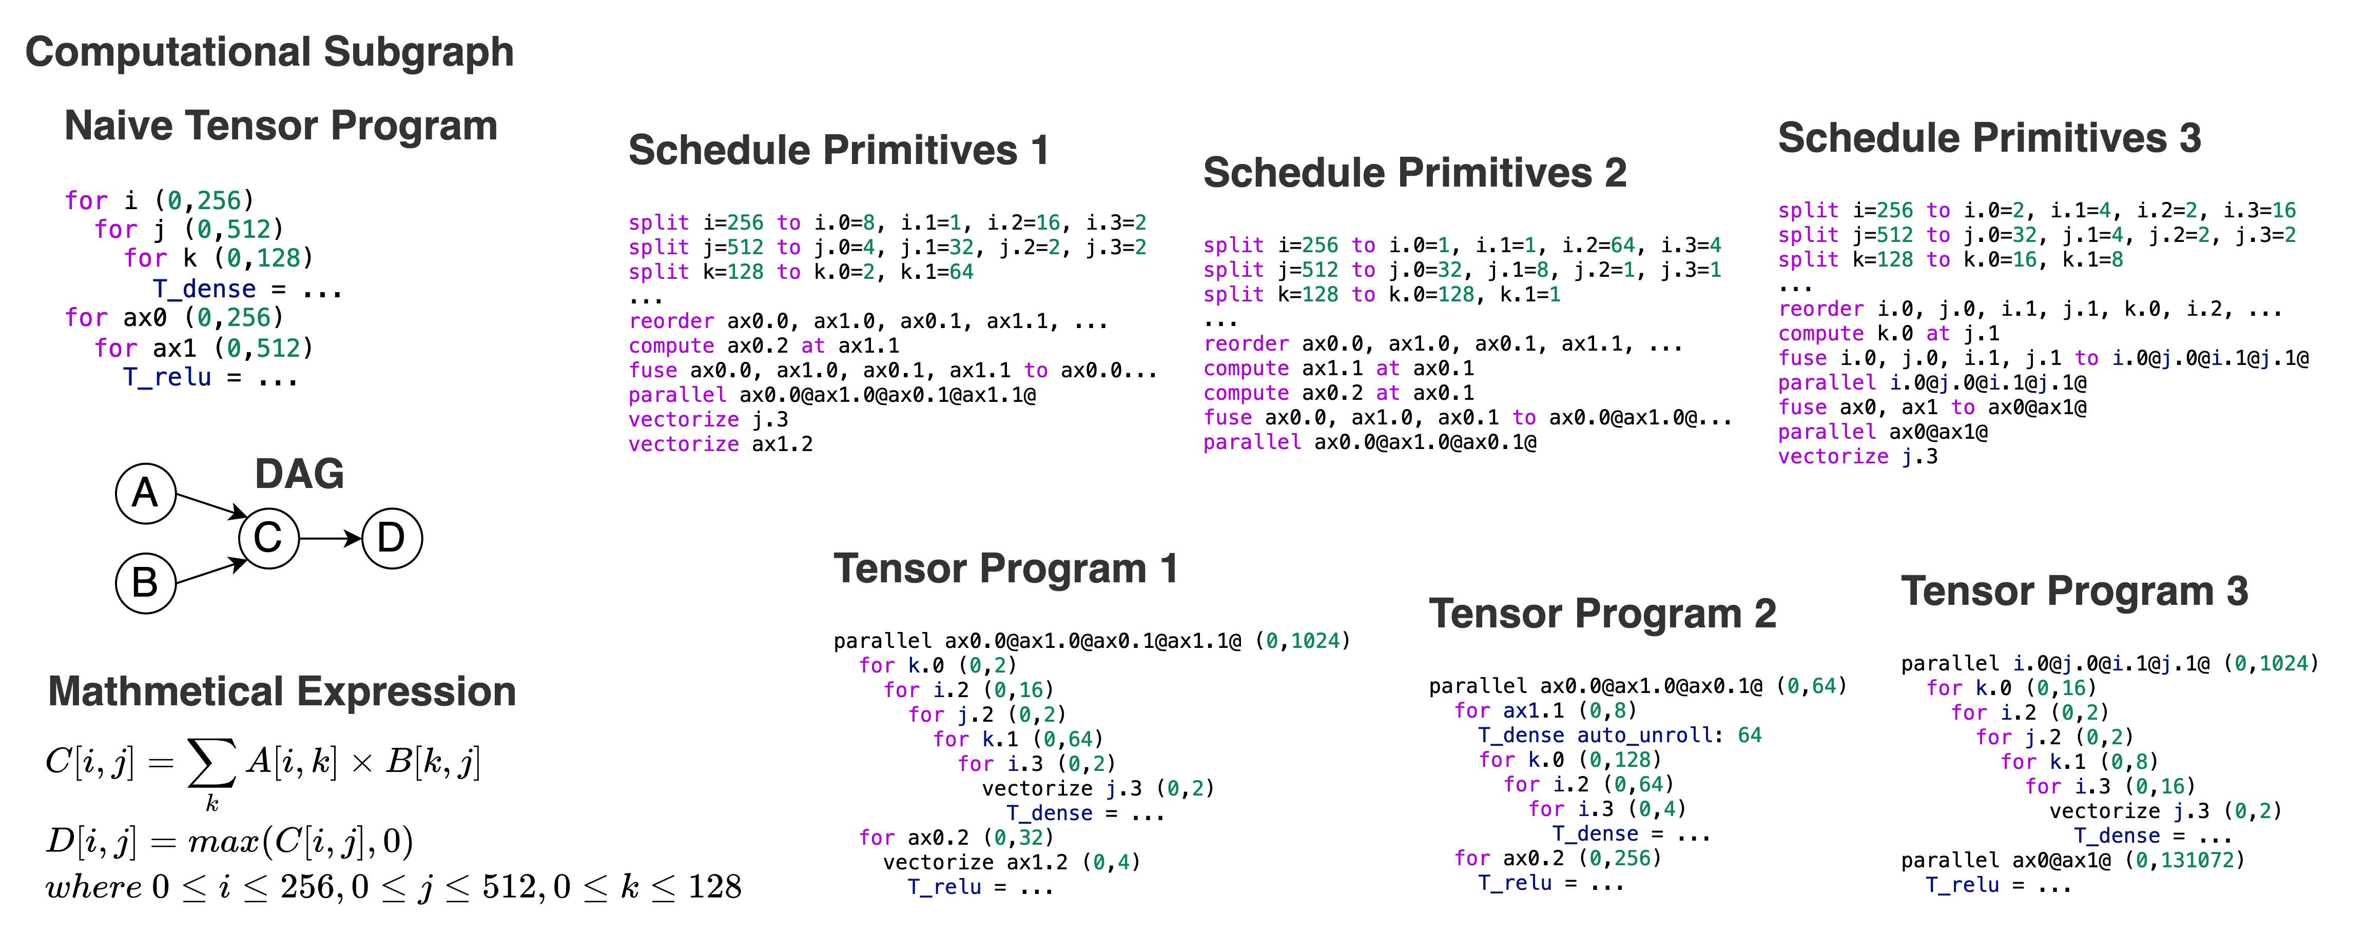
An Example

Slide 4

How to Search?
The most accurate
but inefficient
approach: Execute each candidate on the target hardware.
Subgraph
X 1
$$500ms × {10}^{6} ≈5.78 days$$
Search Algorithm Guided by
Cost Model
How to Search?
Tensor Programs
Previous works:
Empirical Formula Cost Model
Halide16
Online Learning Cost Model
AutoTVM, Ansor, Chameleon, FlexTensor, Halide20
Offline Learning Cost Model
TenSet, TIRAMISU cost model, The work of Benoit Steiner et al.
CPU
X 10⁶
GPU
X 10⁹

Slide 5
Challenges
C1: Feature Extraction
Ansor / TenSet
Extract 164 features from five aspects for the innermost assignment statement
TIRAMISU cost model
Extract 2534 features from the innermost assignment statement
Extract the AST structure as a computational stream to forward propagate input features
Drawbacks
Complex feature engineering
Limited by prior knowledge
Drawbacks
Complex feature engineering
Features are sparse
The AST information in it is difficult to extract and utilize
Ours
Extract features from schedule primitives rather than tensor programs
Treat schedule primitives as tensor language and turn the task of predicting tensor program latency into an NLP regression task

Slide 6
Challenges
C2: Cross-Hardware Unavailability
Data
Machine A
Domain Gap
Machine B
Cost Model
High Performance
Poor Performance

Slide 7
Challenges
C2: Cross-Hardware Unavailability
TenSet
Build a local model to predict the latency gap between the source and target hardware
Moses
Use model distillation to distill out transferable and non-transferable parameters
Drawbacks
Suboptimal performance
Not open source
Ours
Use multi-task learning techniques to solve the cross-hardware unavailability
Use shared and non-shared parameters to fit hardware-independent and hardware-dependent features

Slide 8
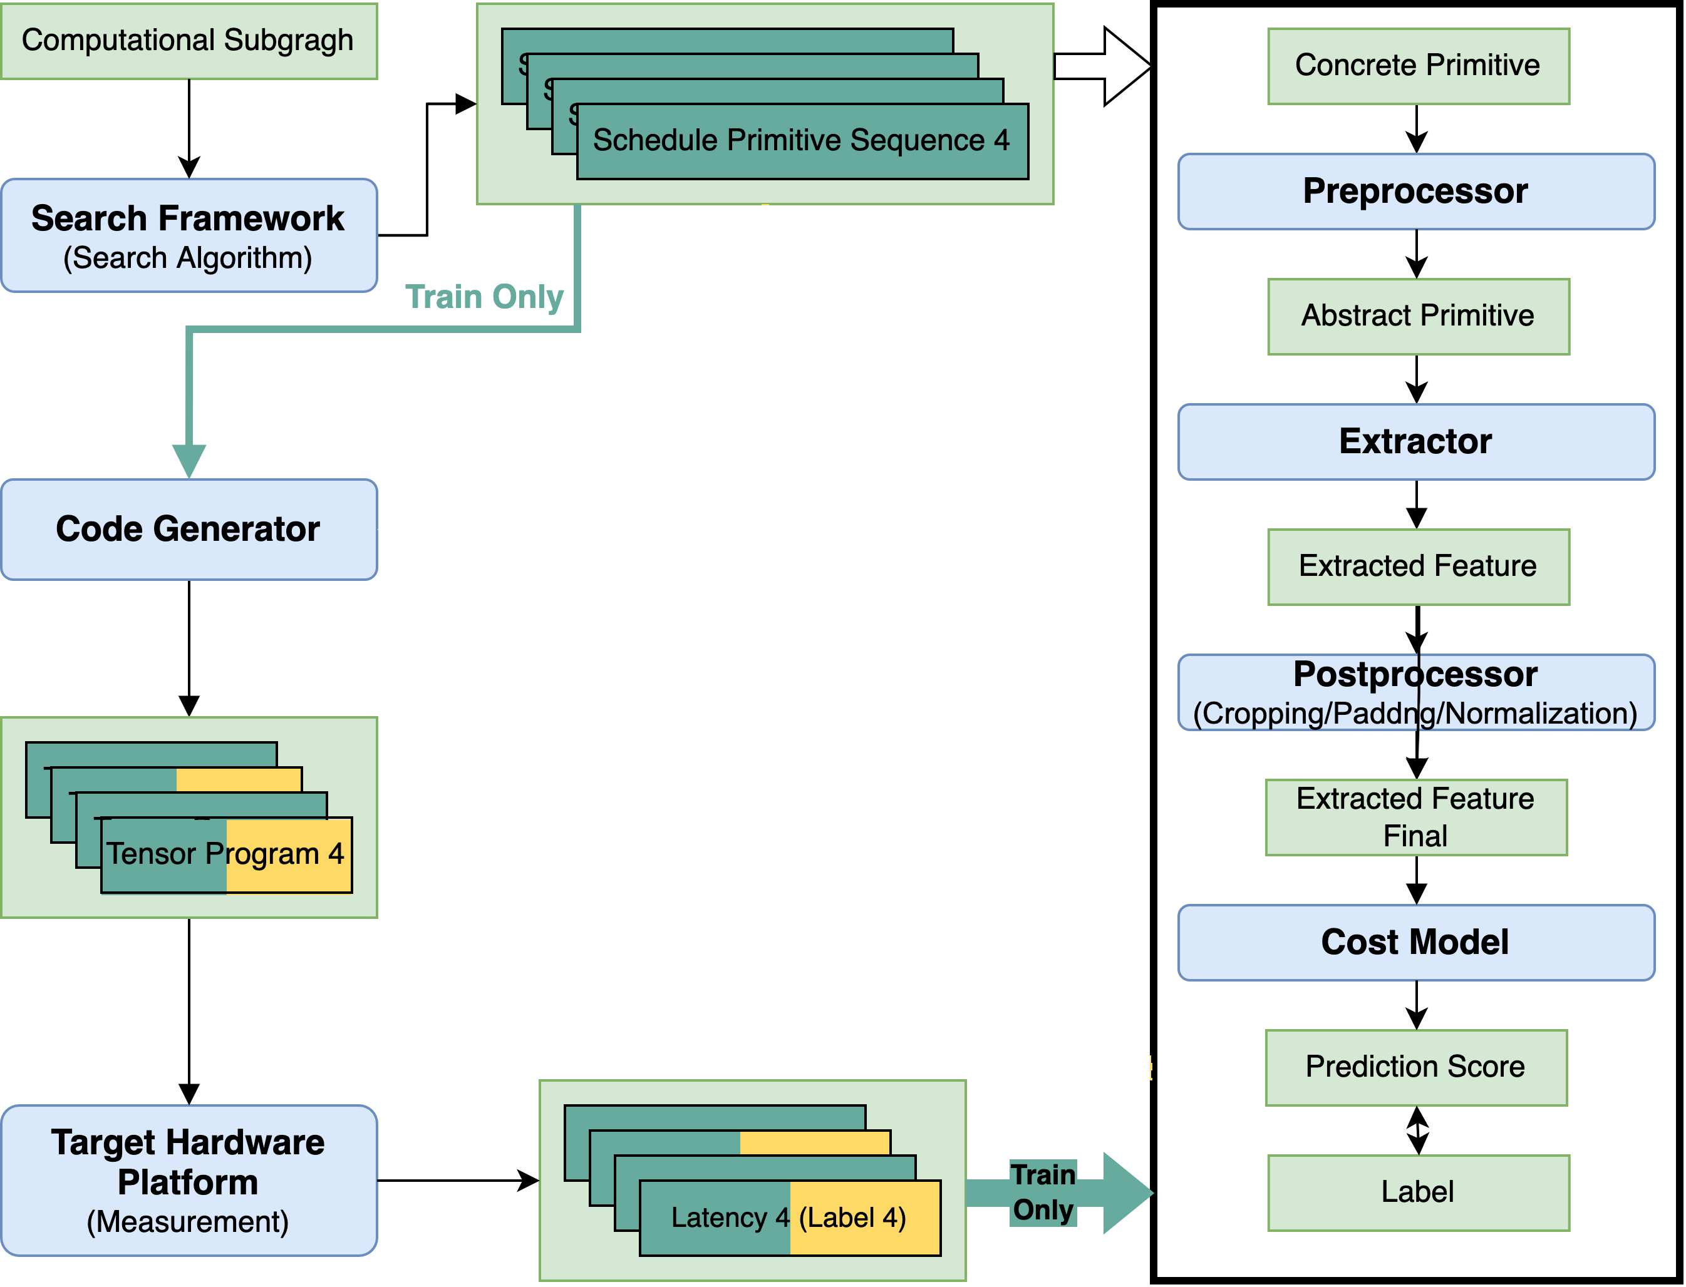
System Overview
Train

Slide 9
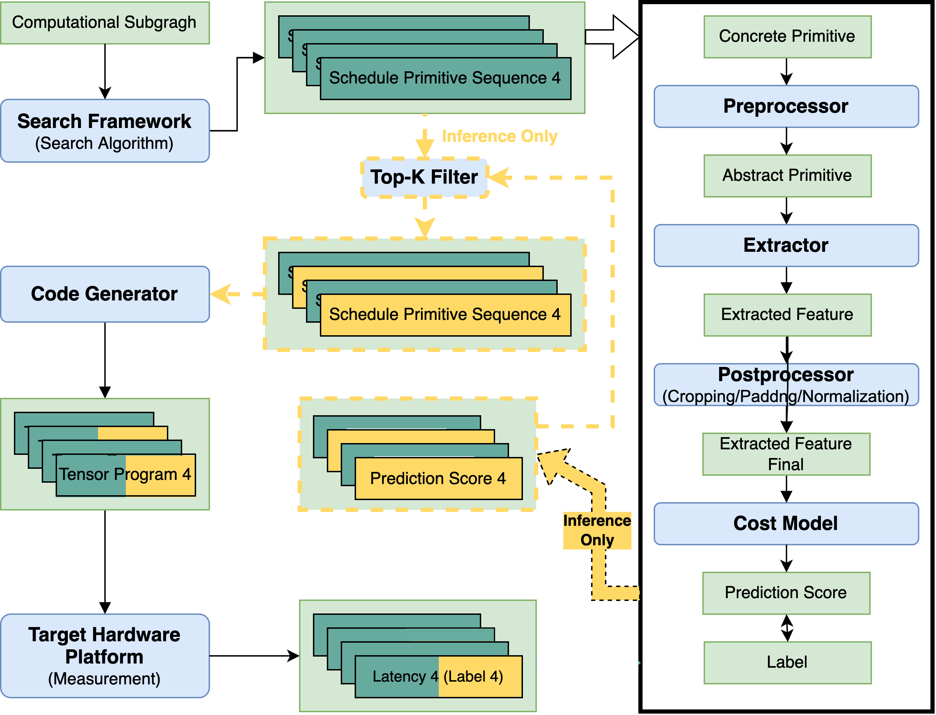
System Overview
Inference

Slide 10
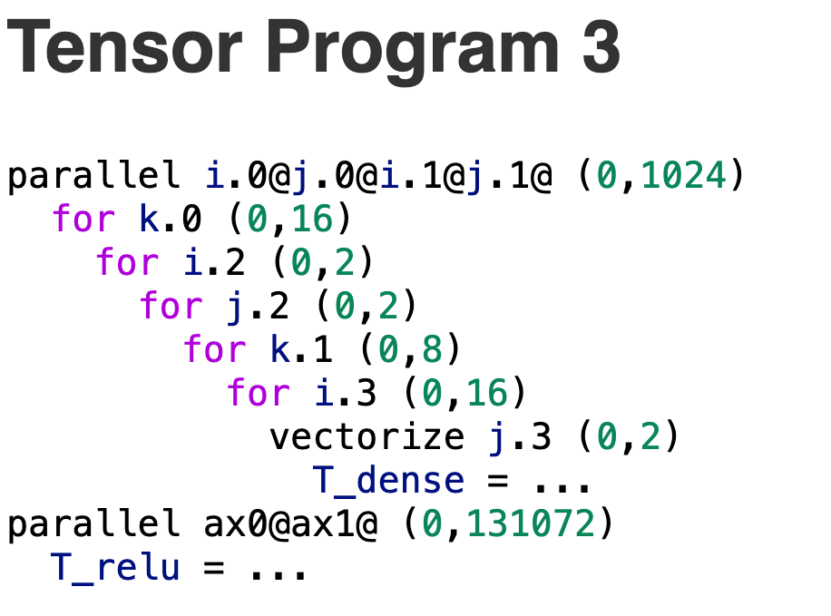
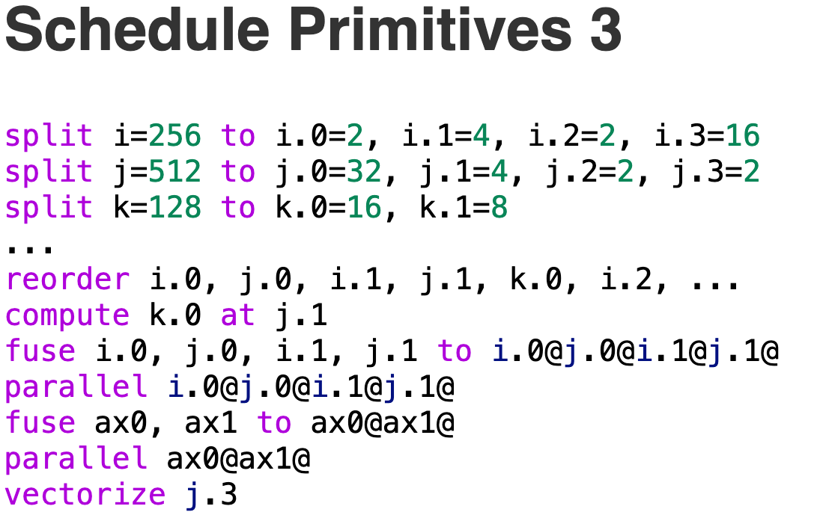
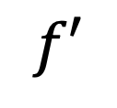
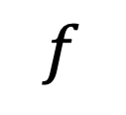
Feature Extraction
WHY?
$$f$$
$$f′$$
HOW?
0.83

Slide 11
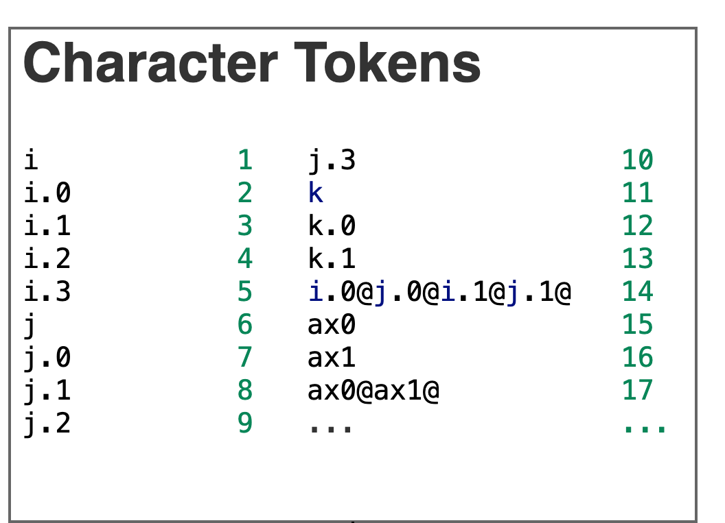
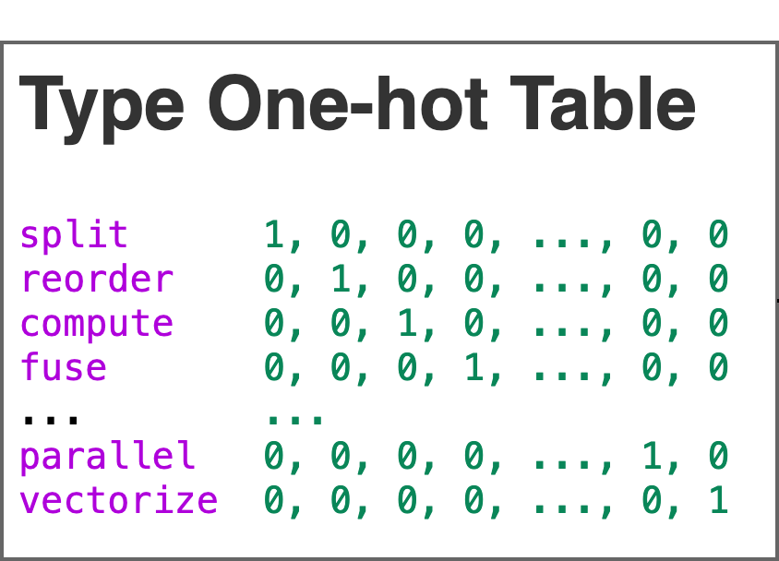
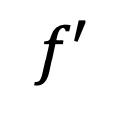
Feature Extraction
HOW?
split i=256 to i.0=2, i.1=4, i.2=2, i.3=16
split, i, 256, i.0, 2, i.1, 4, i.2, 2, i.3, 16
split, i, 256, i.0, 2, i.1, 4, i.2, 2, i.3, 16
split, i, 256, i.0, 2, i.1, 4, i.2, 2, i.3, 16
$$f′$$
1, 0, 0, 0, ..., 0, 0, 1, 256, 2, 2, 3, 4, 4, 2, 5, 16
1, 0, 0, 0, ..., 0, 0, 1, 256, 2, 2, 3, 4, 4, 2, 5, 16
1, 0, 0, 0, ..., 0, 0, 1, 256, 2, 2, 3, 4, 4, 2, 5, 16
0.83

Slide 12
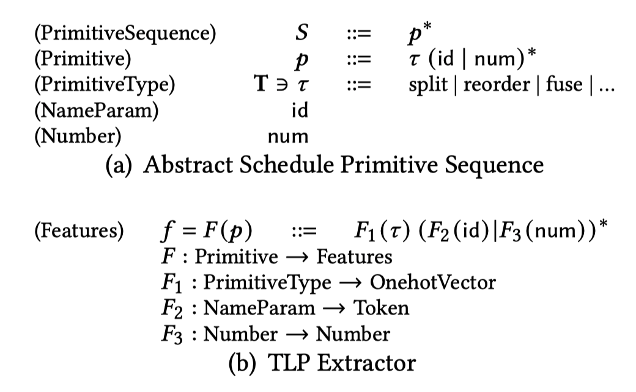
Feature Extraction
Notes:
巴科斯范式

Slide 13
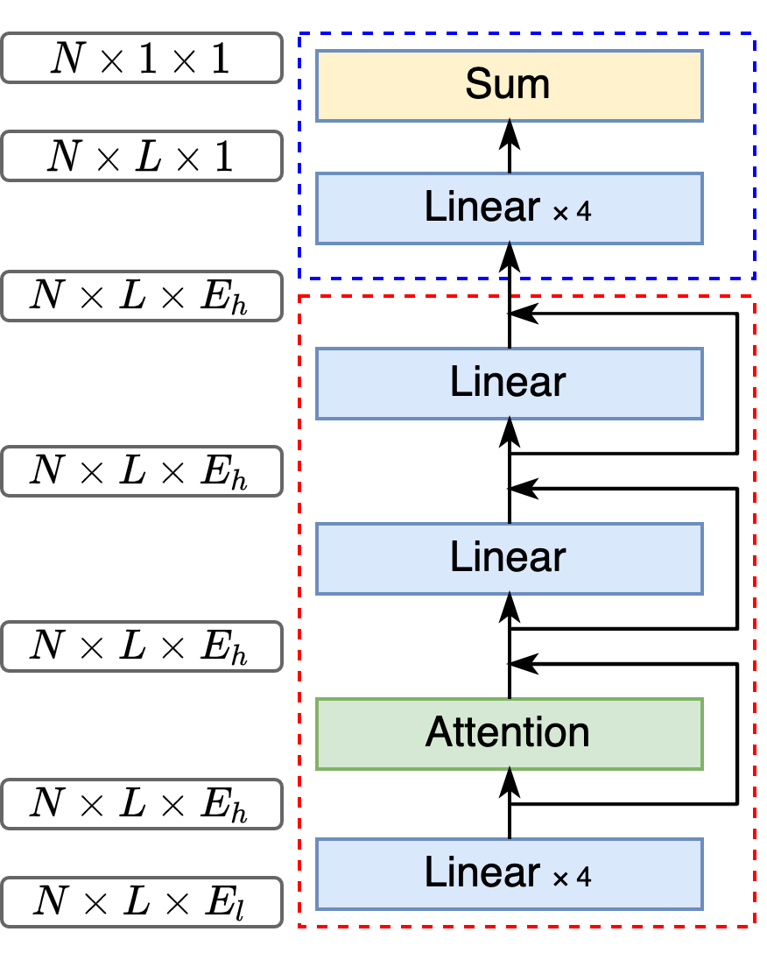
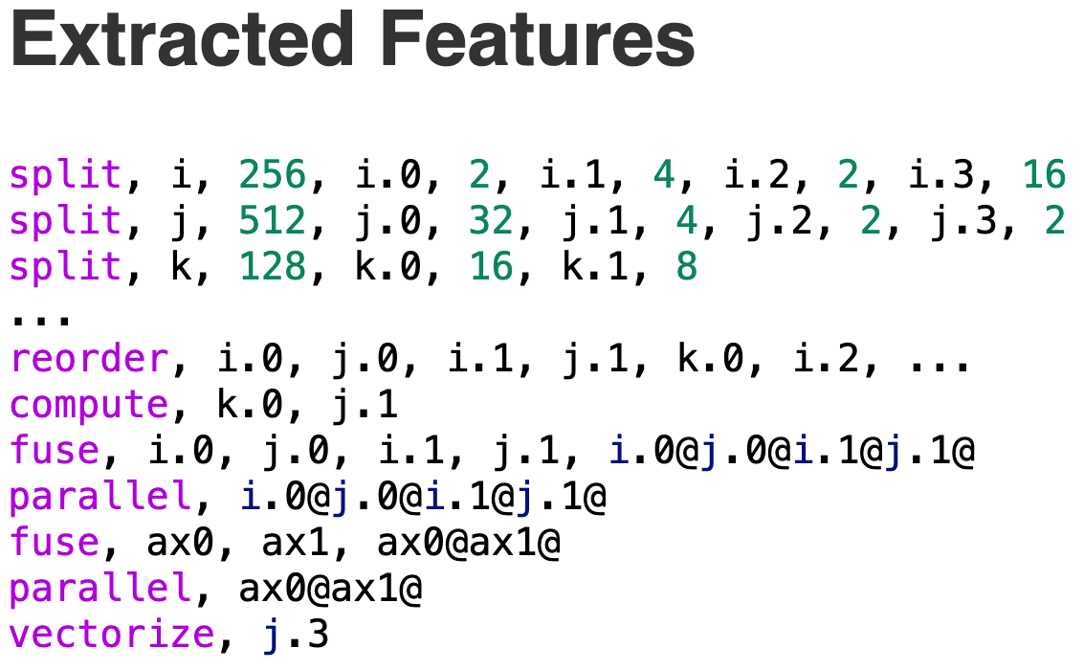
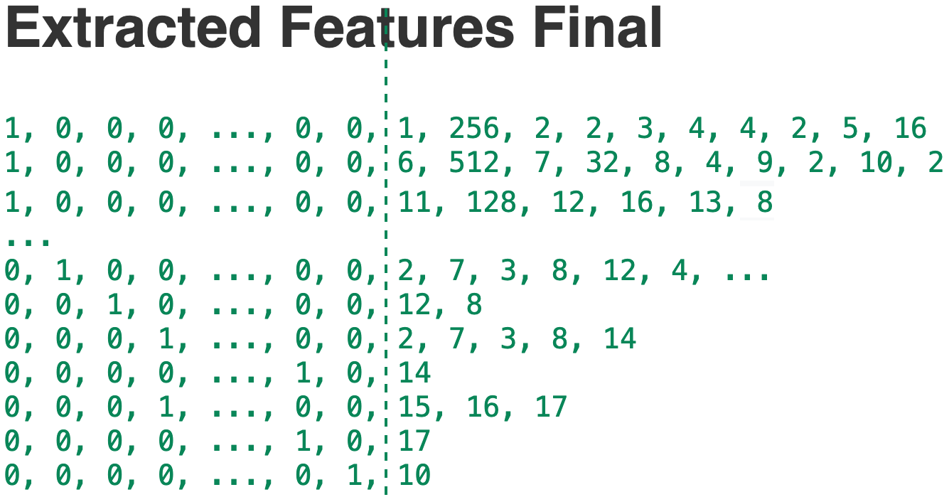
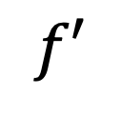
TLP
$$f′$$
0.83

Slide 14
Feasibility Analysis
WHY?
Why can a schedule primitive sequence be considered the equivalent of a tensor program?
Have an almost one-to-one correspondence, containing the same amount of semantic information.
For TenSet CPU dataset, there are 8.56 million different primitive sequences in 8.65 million tensor programs. The repetition rate is only 1.0430%.
If a schedule primitive sequence has two latencies (labels), the cost model does not converge.

Slide 15
Feasibility Analysis
WHY?
Why do we extract features from schedule primitives?
These features are dense and preserve all information considerably.
The primitive sequence is a regular sequence that can take advantage of some existing NLP techniques.
We do not need complex feature engineering.
We call schedule primitive the tensor language. TLP is thus a Tensor Language Processing task.

Slide 16
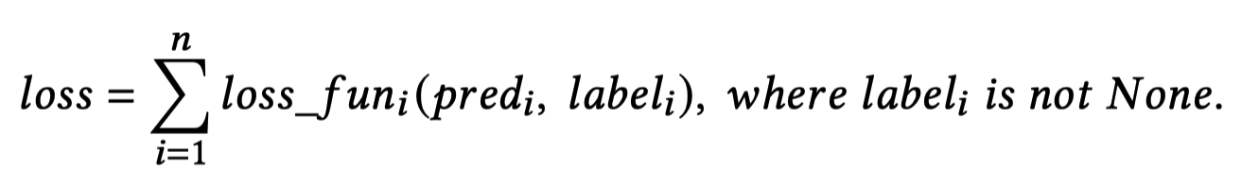
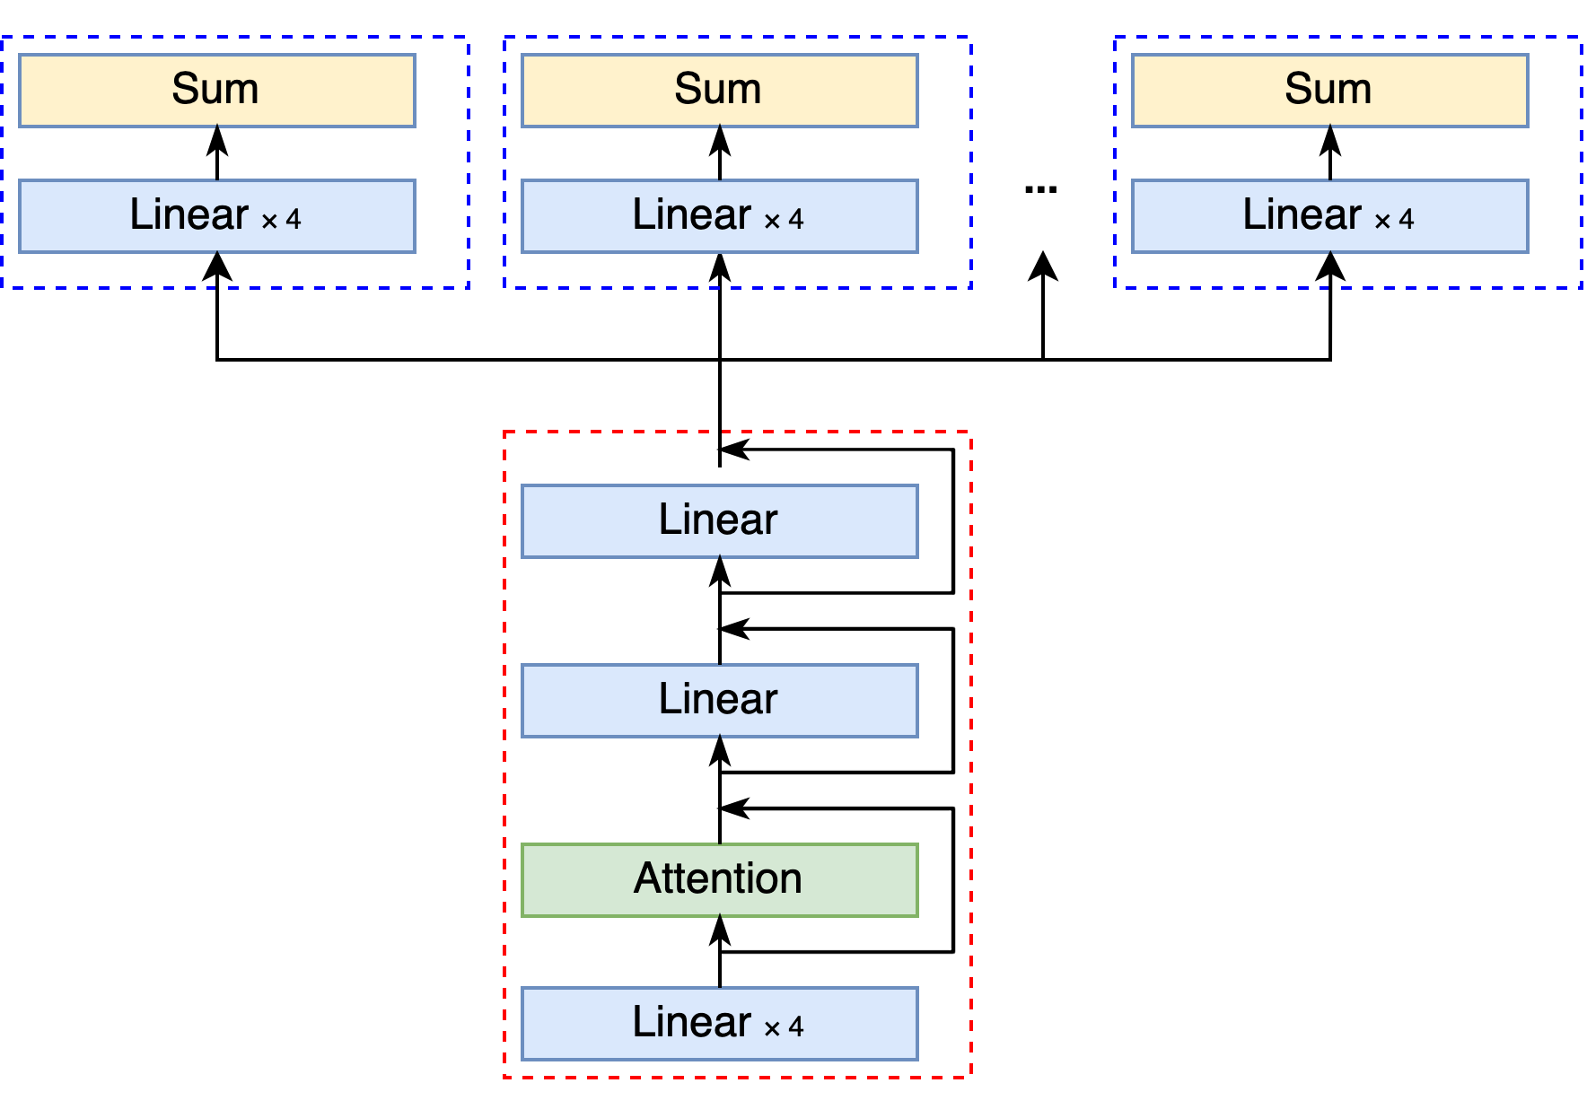
MTL-TLP
Cross-Hardware Unavailability
Domain Gap
Label1: None
Label2: 0.88
Label3: 0.89
A
B
Pred1: 0.53
Pred2: 0.86
Pred3: 0.93
Input Features

Slide 17
Feasibility Analysis
MTL-TLP plays a big role mainly due to the following points:
MTL effectively increases the sample size
In single-task learning, back-propagation of gradients tends to get stuck in local minima. MTL acts as a regularizer by introducing an inductive bias.
MTL-TLP can use shared parameters to fit hardware-independent features and non-shared parameters to fit hardware-dependent features.

Slide 18
Evaluation
Dataset-based metrics
Evaluate the model’s accuracy on a static dataset
Search-based metrics
Evaluate the end-to-end search efficiency or search quality after integrating the cost models into the search algorithms
Notes:
优势是方便很多

Slide 19
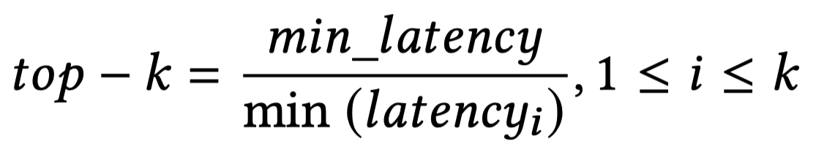
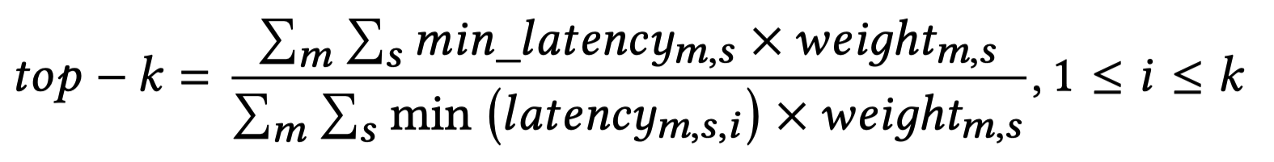
Evaluation
Dataset-Based Metrics
For a subgraph:
For the test set:

Slide 20
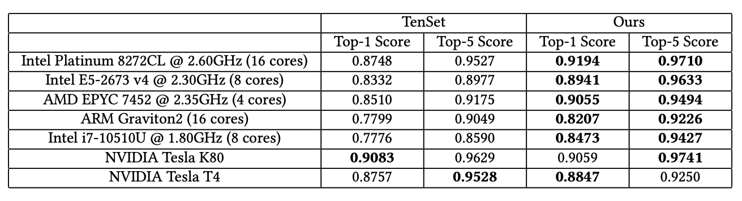
TLP with Dataset-Based Metrics
TLP vs. TenSet MLP
On CPUs, TLP exceeds TenSet MLP by a large margin
On GPUs, TLP and TenSet MLP each have their strengths

Slide 21
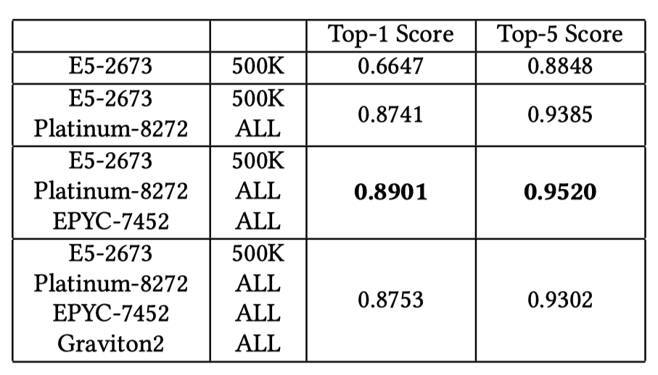
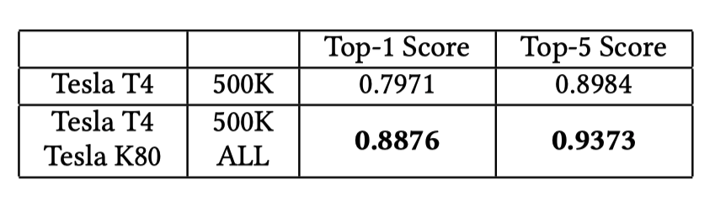
MTL-TLP with Dataset-Based Metrics
CPU
GPU
Use multi-task learning can significantly improve the accuracy
Even trained with only 500K data exceeds the TenSet MLP
Appropriately increasing the number of tasks can improve the accuracy of the cost model
ALL: ≈ 8.59 million

Slide 22
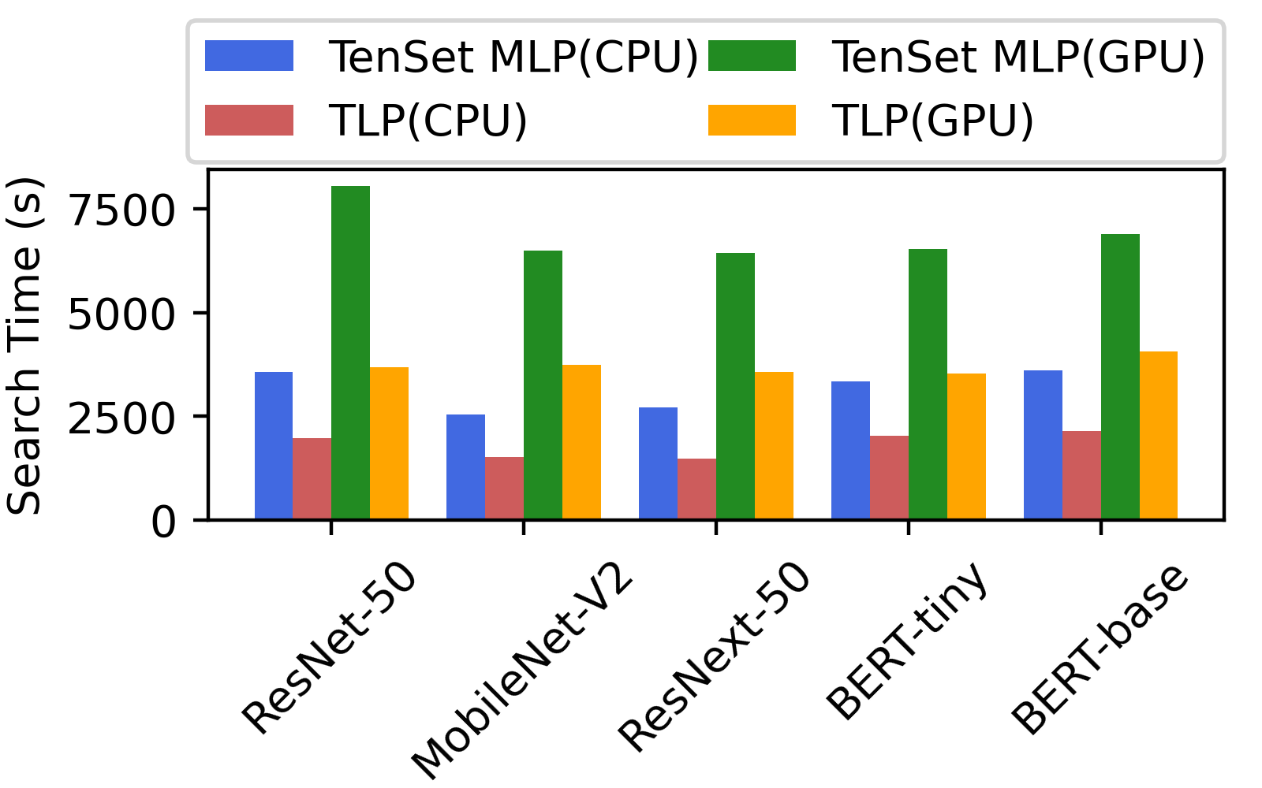
Search-Based metrics
Time in seconds to tune each model 2,000 times:
TLP is on average 1.7× and 1.8× faster than TenSet MLP on the CPU and GPU

Slide 23
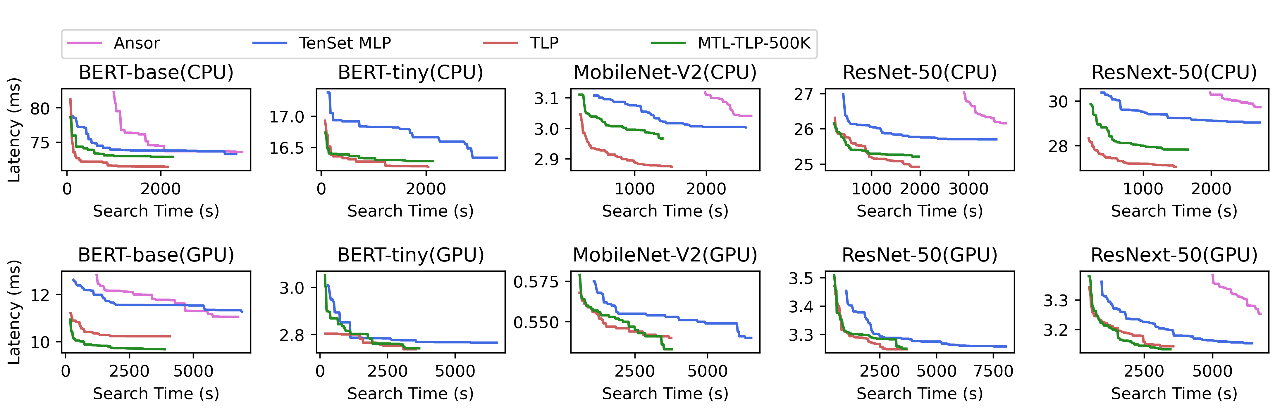
Search-Based metrics
The tuning curves for all workloads:
These curves show that TLP and MTL-TLP can converge to lower values faster.

Slide 24
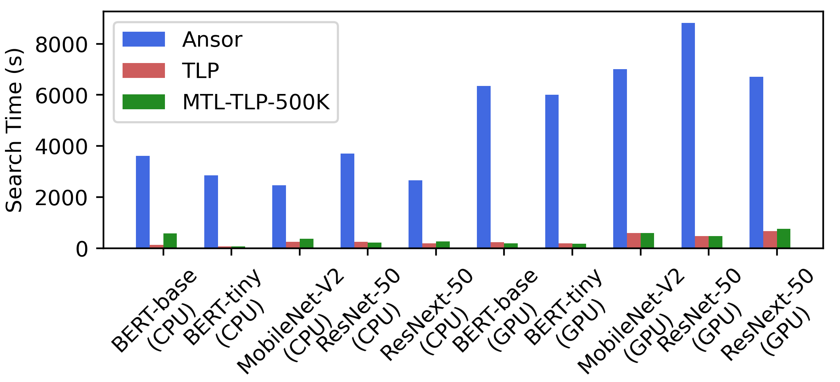
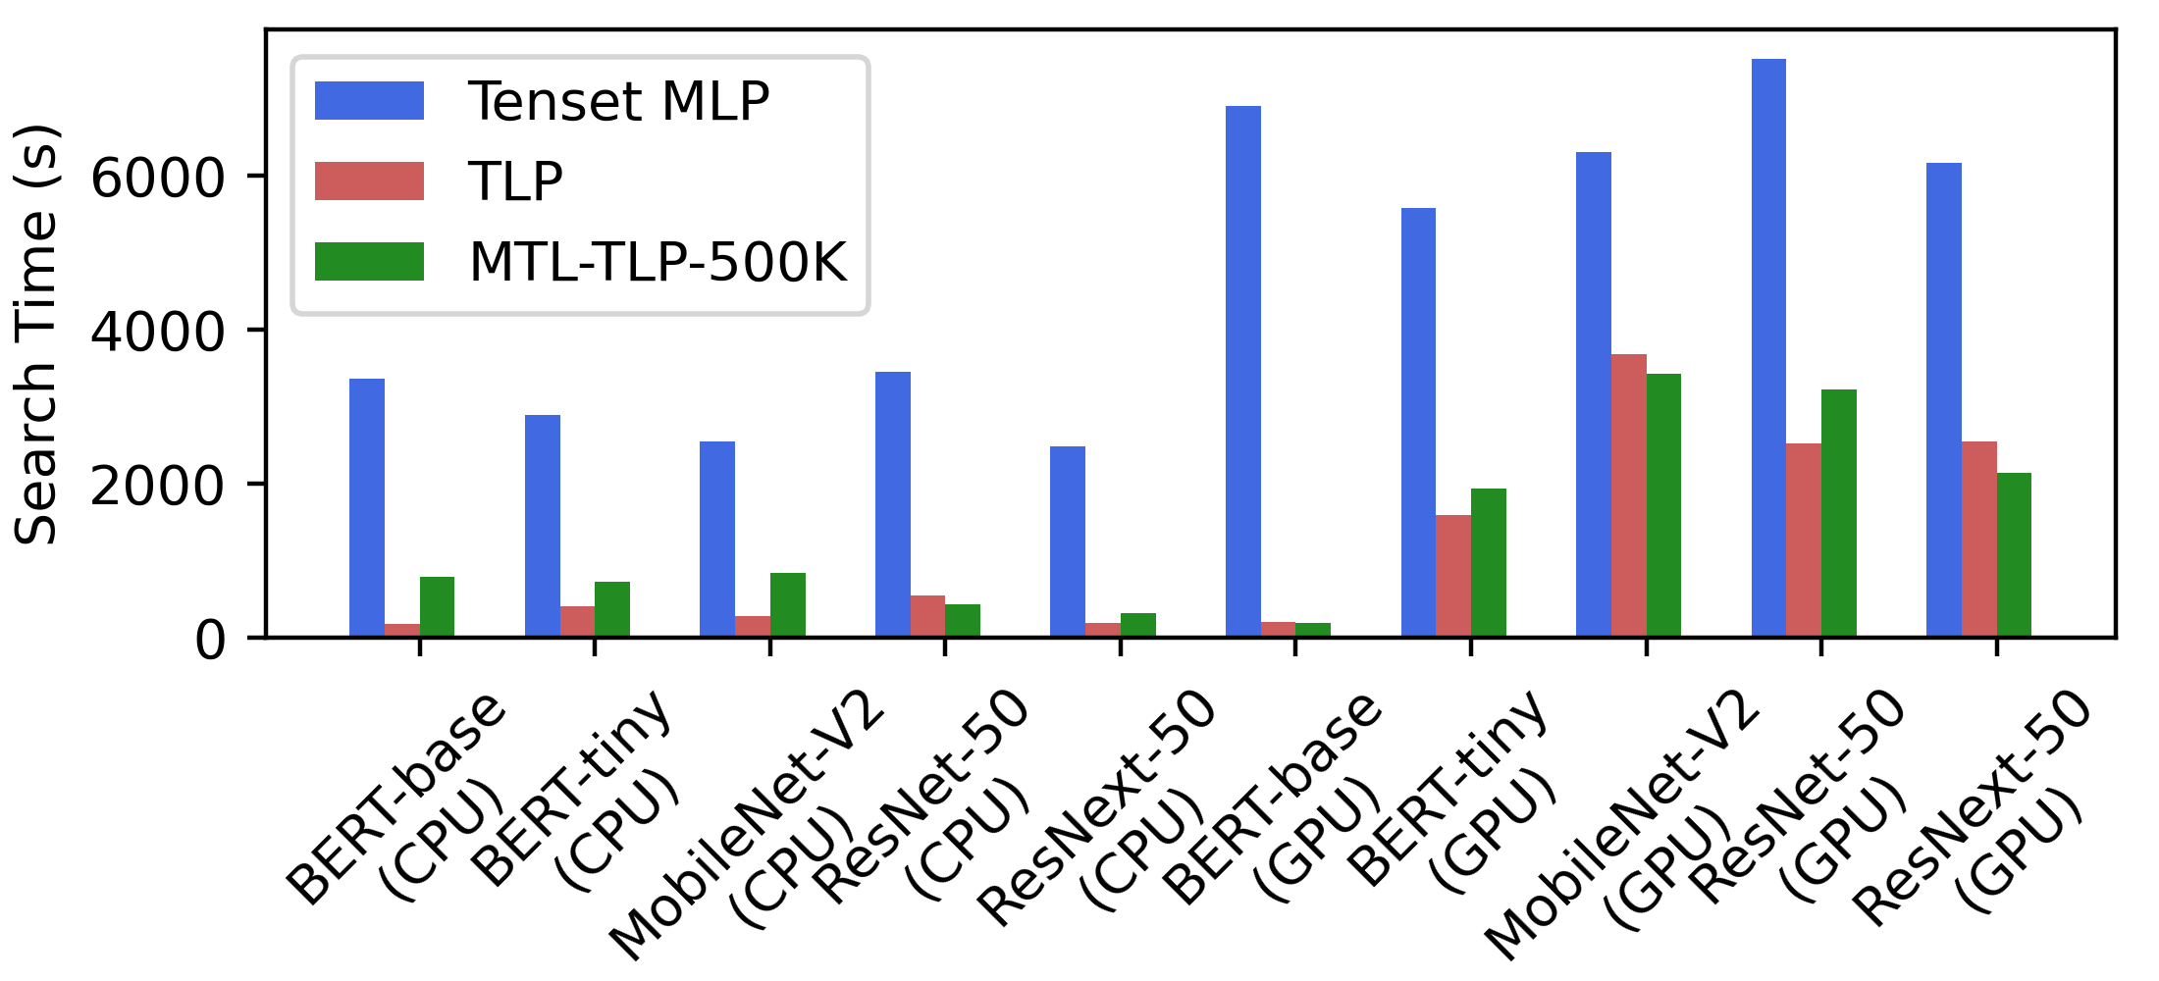
Search-Based metrics
The search time to achieve the performance of Ansor tuning 2,000 times:
The search time to achieve the performance of TenSet MLP tuning 2,000 times:
TLP 16.7X / 16.0X
MTL-TLP 10.0X / 15.8X
TLP 9.1X / 3.0X
MTL-TLP 4.7X / 2.9X

Slide 25
Summary
A simple yet efficient and general feature extraction mechanism for tensor programs
A multi-task learning method to address offline cost model unavailability across hardware platforms
An solid implementation and comprehensive evaluation of the TLP and MTL-TLP demonstrate that the above techniques outperform state-of-the-art implementation on various deep learning models and hardware platforms
Thank you for listening
Email me to ask follow-up questions: zhaiyi0@mail.ustc.edu.cn

